Slide 1


OMICS international
OMICS International through its Open Access Initiative is committed to make genuine and reliable contributions to the scientific community. OMICS International hosts over 700 leading-edge peer reviewed Open Access Journals and organizes over 1000 International Conferences annually all over the world. OMICS International journals have over 10 million readers and the fame and success of the same can be attributed to the strong editorial board which contains over 50000 eminent personalities that ensure a rapid, quality and quick review process. OMICS International signed an agreement with more than 1000 International Societies to make healthcare information Open Access.
Contact us at: contact.omics@omicsonline.org

Slide 2

OMICS Journals are welcoming Submissions
OMICS International welcomes submissions that are original and technically so as to serve both the developing world and developed countries in the best possible way.
OMICS Journals are poised in excellence by publishing high quality research. OMICS International follows an Editorial Manager® System peer review process and boasts of a strong and active editorial board.
Editors and reviewers are experts in their field and provide anonymous, unbiased and detailed reviews of all submissions.
The journal gives the options of multiple language translations for all the articles and all archived articles are available in HTML, XML, PDF and audio formats. Also, all the published articles are archived in repositories and indexing services like DOAJ, CAS, Google Scholar, Scientific Commons, Index Copernicus, EBSCO, HINARI and GALE.
For more details please visit our website: http://omicsonline.org/Submitmanuscript.php

Slide 3


Editorial Board
Jacek Dutkiewicz
Professor
University Fribourg
Germany
Tel: 4881-71-84-525

Slide 4
Biography
Born on 29 July 1934 in Luck. Graduated in biology at Jagiellonian University (JU) in Cracow (1956), gained PhD degree at the JU (1965), degree of Dr habil. at the Medical University in Lublin (1977) and title of Professor from the President of Poland (1991). Employed at the State Institute for Nature Protection in Cracow (1956-1958), at the Medical University in Cracow (1958-1965) and at the State Institute of Rural Health in Lublin since 1966 until now. In the years 1987-1989 Senior Research Associate of the National Research Council at the NIOSH, Morgantown, WV, USA..
> > >

Slide 5
Jacek Dutkiewicz research interest include occupational biohazards, in particular on: bioaerosols in agriculture and forestry, microorganisms causing zoonoses, ticks and tick-borne diseases, classification of occupational biohazards in all professions.

Slide 6
Publications
Air Pollution in Health and Diseases
Dominique H Limoli, Andrea B Rockel, Kurtis M Host, Anuvrat Jha, Benjamin T Kopp, Thomas Hollis, Daniel J Wozniak
Polysomnographic Differences Associated with Pulmonary Hypertension in Patients with Advanced Lung Disease Due to Cystic Fibrosis.
Don Hayes, Curt J Daniels, Stephen Kirkby, Benjamin T Kopp,Kerri L Nicholson, Ashley E Nance, Mark L Splaingard

Slide 7
Detrimental effects of secondhand smoke exposure on infants with cystic fibrosis
Benjamin T. Kopp, Lisa Sarzynski, Sabrina Khalfoun, Don Hayes,Rohan Thompson, Lisa Nicholson, Frederick Long, Robert Castile, Judith Groner
Comprehensive evaluation of lung allograft function in infants after lung and heart-lung transplantation.
Don Hayes, Aymen Naguib, Stephen Kirkby, Mark Galantowicz,Patrick I McConnell, Peter B Baker, Benjamin T Kopp, Eric A Lloyd, Todd L Astor

Slide 8
Survival of patients with cystic fibrosis on ECMO: analysis of the Extracorporeal Life Support Organization Registry.
Don Hayes, Benjamin T Kopp, Thomas J Preston, Stephen Kirkby,Joseph D Tobias, Thomas J Papadimos, Bryan A Whitson
IFN-γ Stimulates Autophagy-Mediated Clearance of Burkholderia cenocepacia in Human Cystic Fibrosis Macrophages.
Kaivon Assani, Mia F Tazi, Amal O Amer, Benjamin T Kopp

Slide 9
Comprehensive evaluation of lung allograft function in infants after lung transplantation
Don Hayes, Aymen Naguib, Stephen Kirkby, Mark Galantowicz,Peter B. Baker, Benjamin T. Kopp, Eric A. Lloyd, Todd L. Astor
Respiratory syncytial virus: current and emerging treatment options.
Tiffany L Turner, Benjamin T Kopp, Grace Paul, Lindsay C Landgrave, Don Hayes, Rohan Thompson

Slide 10
Surveillance transbronchial biopsies in infant lung and heart-lung transplant recipients.
Don Hayes, Peter B Baker, Benjamin T Kopp, Stephen Kirkby,Mark Galantowicz, Patrick I McConnell, Todd L Astor
Right heart catheterization measuring central hemodynamics in cystic fibrosis during exercise.
Don Hayes, Curt J Daniels, Heidi M Mansour, Benjamin T Kopp,Andrew R Yates, Karen S McCoy, Alpa V Patel, Stephen Kirkby

Slide 11
Elevated high-sensitivity C-reactive protein in preterm infants with pulmonary colonization with Ureaplasma.
John T Meadows, Benjamin T Kopp, Lori A Shook, Hubert O Ballard, Don Hayes
Light exposure and depression in hospitalized adult patients with cystic fibrosis.
Benjamin T Kopp, Don Hayes, Mia Ratkiewicz, Nancy Baron,Mark Splaingard
Diabetic myonecrosis in a cystic fibrosis patient.
Benjamin T Kopp, Stephen Kirkby, Don Hayes, Kevin M Flanigan

Slide 12
Pulmonology
Pulmonology is a medical specialty that deals with diseases involving the respiratory tract. Pulmonology is synonymous with pneumology, respirology and respiratory medicine.
Pulmonology is known as chest medicine and respiratory medicine in some countries and areas. Pulmonology is considered a branch of internal medicine, and is related to intensive care medicine.
Pulmonology often involves managing patients who need life support and mechanical ventilation. Pulmonologists are specially trained in diseases and conditions of the chest, particularly pneumonia, asthma, tuberculosis, emphysema, and complicated chest infections.

Slide 13
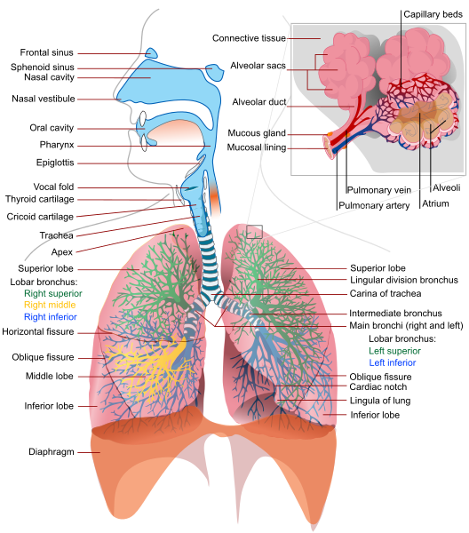

Slide 14
Diagnosis
The pulmonologist begins the diagnostic process with a general review focusing on:
hereditary diseases affecting the lungs (cystic fibrosis, alpha 1-antitrypsin deficiency)
exposure to toxins (tobacco smoke, asbestos, exhaust fumes, coal mining fumes)
exposure to infectious agents (certain types of birds, malt processing)
an autoimmune diathesis that might predispose to certain conditions (pulmonary fibrosis, pulmonary hypertension)

Slide 15

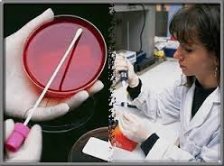
Journal of Air & Water Borne Diseases
Related Journals
Journal of Bacteriology & Parasitology
Journal of Medical Microbiology & Diagnosis
Journal of Microbial & Biochemical Technology
Journal of Plant Pathology & Microbiology
Journal of Vaccines & Vaccination

Slide 16

Journal of Air & Water Borne Diseases
Related Conferences
Allergy Conference
4th Bacteriology and Infectious Diseases Conference
2nd Infectious Diseases Congress

Slide 17


OMICS International Open Access Membership
OMICS International Open Access Membership enables academic and research institutions, funders and corporations to actively encourage open access in scholarly communication and the dissemination of research published by their authors.
For more details and benefits, click on the link below:
http://omicsonline.org/membership.php

