Slide 1
Prof. Mohamed A. Awad
Editor- In-Chief
Journal of Oral Hygiene & Health
(JOHH)
e.mail: mohamed_awad61@yahoo.com

Slide 2
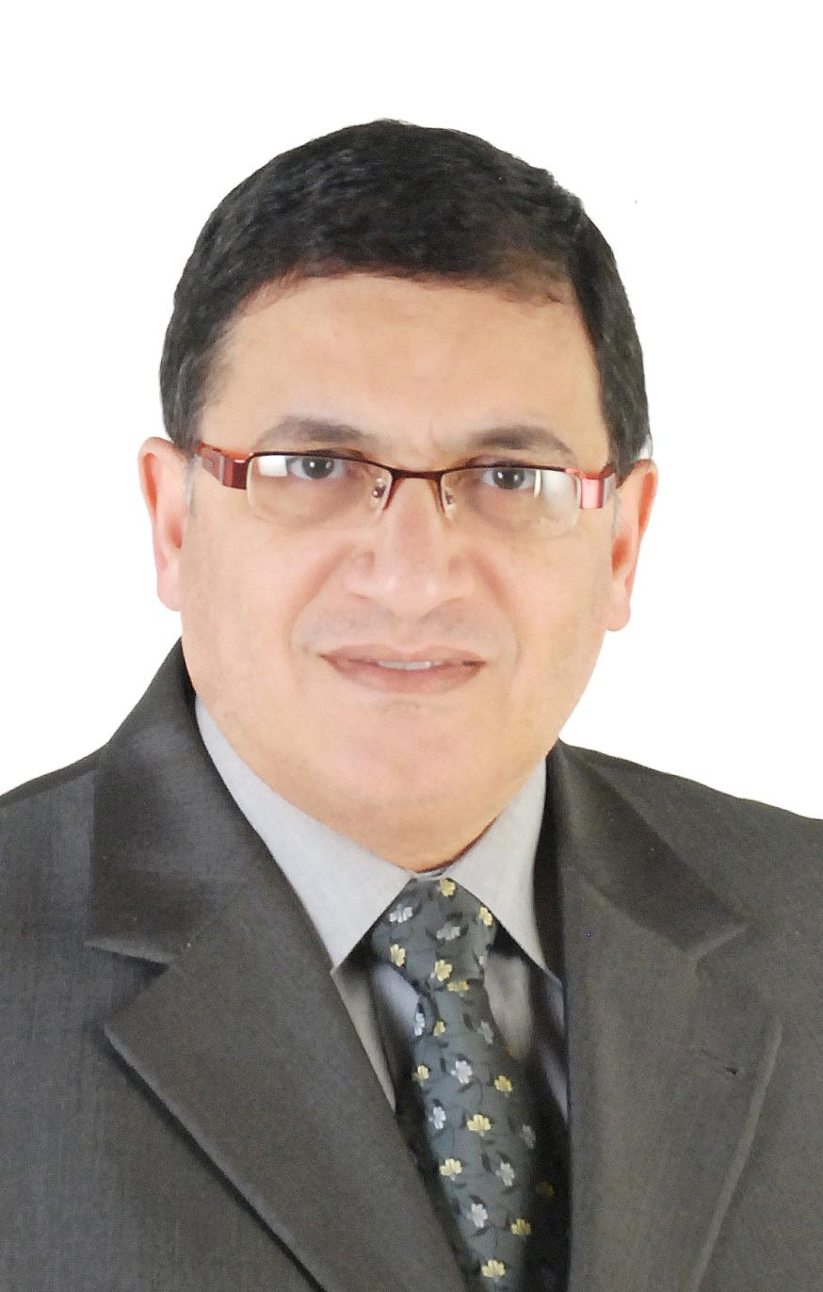
Years practicing and performing Research
More than thirty years
Got BDS (Egypt, 1983); MSc (Egypt, 1989); PhD (England, 1996).
Associate Professor & Consultant, Fixed Prosthodontic Department, Faculty of Dentistry, Tanta University, Egypt.
Visiting Professor & Consultant, Fixed Prosthodontic Division, King Abdulaziz University, Saudi Arabia.

Slide 3
Societies & Associations
President of Egyptian Association for Dental Research Section of International Association for Dental Research (IADR) since July 2010
Member in the Egyptian Dental Syndicate (EDS)
Member in the British Society for the Study of Prosthetic Dentistry (BSSPD)
Member in the British Dental Association (BDA)
Member in the Academy of Dental Materials
Member in the Saudi Dental society.

Slide 4
Who’s Who
Biographical profile has been selected by Marquis Who's Who for inclusion in Who's Who in the World® 2015 (32nd Edition).

Slide 5
Positions Held
Head of Fixed Prosthodontics Division Faculty of Dentistry, King Abdulaziz University, (Sept, 2003-Sept 2004)
Associate Professor & Consultant, Faculty of Dentistry, Tanta University, Egypt and King Abdulaziz University, Saudi Arabia to date.
Assisstant Professor & Consultant, Faculty of Dentistry, Tanta University, Egypt and King Abdulaziz University, Saudi Arabia.
PhD Student, Department of Restorative Dentistry (Nov 1992-Dec 1996) University of Manchester, United Kingdom.

Slide 6
Responsibilities
Head of Fixed Prosthodontics Division Faculty of Dentistry, King Abdulaziz University, (Sept, 2003-Sept 2004).
Fixed Prosthodontics Course Director of Fourth and Fifth Year Department of Oral & Maxillofacial Rehabilitation, Fixed Prosthodontics Division, Faculty of Dentistry, King Abdulaziz University for many years.
Fixed Prosthodontics Course Director of Sixth Year Sept 2014– to date.
Supervising and teaching postgraduate Saudi Board in Advanced Restorative Dentistry (SBARD) since year 2000.

Slide 7
Conferences
Presented researches and lectures in several international conferences all over the world including: Miami, San Diego, Seattle (USA), Singapore, Manchester & Bristol (England), Riyadh, Jeddah, Makkah (Saudi Arabia), Dubai (UAE), Kuwait and Egypt.

Slide 8
Awards & Grants
Awarded several awards including distinction in scientific research in King Abdulaziz University, 2008.
Scholarship grant from Ministry of Higher Education, Egypt to get PhD from Manchester, UK, 1992.
Held several grants for conducting researches from different associations.
Serves for editorial board and as a reviewer for many scientific international journals.

Slide 9
My Research Interest
Dental materials and Fixed Prosthodontic Researches including:
  Dental ceramics
  Zirconium post and cores
  Fiber-reiforced composite restorations & post/cores
  Color & Dental esthetics
  Base metal alloys
  Wear and abrasion in dental ceramics
  Optical properties of natural teeth and dental ceramics
  Finite element analysis
  Dental implant materials
  Dental cements
  Periodontal problems related to Fixed Prosthodontic Restorations

Slide 10
Some Researches Published
Awad MA (1989): Comparison of the bond strength of commercially available dentine bonding agents MSc thesis, Tanta University, Egypt.
Awad MA (1996): Factors affecting the performance of composite luting cements within the oral cavity. PhD thesis, University of Manchester, UK.
Mahrous MA and Awad MA (2001): Shear bond strength of cobalt chromium casted restorations to gallium and amalgam core materials using different luting cements. Egyptian Dental Journal 47 (3): 1529-1535.
Maghrabi AA, Awad M A and Shehata MM (2001): Degree of conversion and compressive strength of recently introduced dental composites as a core build up materials. Egyptian Dental Journal 47 (3): 1469-1478.
Mahrous MA and Awad MA (2002): Shear bond strength of titanium, cobalt and nickel chromium fixed restorations to dentin surfaces using two resin adhesives. Egyptian Dental Journal 48 (4): 1843-1849.
Awad MA (2003): Stress analysis of resin cements under ceramic restorations. Egyptian Dental Journal 49 (2): 1115-1130.
Mahrous MA and Awad MA (2003): Effect of different converging angles of casted nickel chromium cores on the retention of fixed restorations using different types of luting cements. Ain shams Dental Journal 6 (2): 99-115.

Slide 11
Some Researches Published (cont.)
Awad MA, Maghrabi AA and Seif RE (2003): Influence of the ferrule effect and prefabricated post type on the fracture resistance of endodontically treated crowned teeth. Egyptian Dental Journal 49 (3): 1155-1162.
Awad MA and Elhejazi AA (2003): Effect of water sorption on color stability of resin veneering materials to fixed restorations. Egyptian Dental Journal 49 (4): 1773-1781.
Mahrous MA and Awad MA (2004): Effect of using adhesive resin cements on the retention of fixed restorations cemented to preparations having several convergence angles. Egyptian Dental Journal 50 (3):1695-1703.
Mahrous MA and Awad MA (2004): Evaluation of bacterial colonization on different treated ceramic surfaces. Egyptian Dental Journal 50 (4): 1815-1821.
Awad MA and Maghrabi AA (2006): Flexural strength of preimpregnated fiber reinforced composite bars simulating fixed partial dentures. Egyptian Dental Journal 52 (3): 1483-1495.
Awad MA and Marghalani TY (2007): Fabrication of custom-made ceramic post & core using CAD-CAM technology. Journal of Prosthetic Dentistry 98 (2): 161-162.
Awad MA (2009): Dental ceramics. Published in King Abdulaziz University scientific chairs book by Research and Consulting Institute, August 2009, page 120-121.

Slide 12
Some Researches Published (cont.)
Awad MA and Ghulman MA (2010): Effect of different bleaching materials on surface roughness and microhardness of fiber reinforced composite fixed restorations. International Journal of Clinical Dentistry 3 (4): 253-274.
Marghalani TY, Hamed MT, Awad MA, Naguib GH and Elragi AF (2012): Three-dimensional finite element analysis of custom-made ceramic dowel made using CAD-CAM technology. J Prosthodont 21: 440-450.
Ghulman MA and Awad MA (2013): Color variation between matched and fabricated shade of different ceramics. J Prosthodont 22: 472-477.
Awad MA and Abdelrehim TR (2013): Retention of implant-supported fixed restorations using different provisional luting agents. Oral Hyg Health 1(2): 1-4.
Awad MA (2014): Brief Outline of Dr. Mohamed Awad Research Vision. Oral Hyg Health 2: e107. doi: 10.4172/2332-0702.1000e107.
Awad MA and Abdulghaffar HS (2014): Custom-made post and core. Part I: Technique to fabricate direct custom-made post with resin pattern. Journal of Dental Health, Oral Disorders and Therapy 1(3): 00013.
Awad MA (2014): Custom-made post and core. Part II: Fabrication of direct resin core using special mold. Journal of Dental Health, Oral Disorders and Therapy 1(3): 00014.

Slide 13
What makes an article top quality?
Simulating clinical performance
Make good literature review to know the lacked points need research.
Standardization of all factors affecting research except the ones which are working on.
Doing enough samples to get good statistical analysis
Using good equipments smart enough to get good results.

Slide 14
What are the qualities we look for in an article?
Good and recent literature review
Good design of materials and methods
Good statistical analysis
Good presentation of results
Right formatted results
Good and valuable discussion
Good English writing

Slide 15
What is the purpose of serving as an Editor-In-Chief?
Help to enhance research in my field.
Select the best researches to publish in order to enhance knowledge of dentists especially juniors.
Help to enhance quality of life of patients.

Slide 16
How to differentiate JOHH with other journals in the field?
JOHH has many advantages including:
  Published to the Web.
  Ease of getting articles freely.
  Do not take long time for reviewing and publishing.
  Top quality and fine selected board and reviewers staff in different fields of dentistry.
  Always trying to be enhance the quality of services supplied by the journal to the dental community.

